Slide 1


VEMANA INSTITUTE OF TECHNOLOGY Koramangala, Bengaluru-34. Department of Computer Science and Engineering Project Phase-II Review 4
Batch No. 24 - NETWORK MONITOR
Under the Guidance of
Mr. NOOR BASHA,
Asst. Professor Department of CSE,
Vemana Institute of Technology
By
PAVITHRA K – 1VI17CS071
RAJASHREE – 1VI17CS114

Slide 2
Bird View
2020 - 21
Network Monitor
Abstract
Introduction to the work
Literature Survey
Comparative analysis of the survey
Problem Statement
System Requirements
Design Methodology
Module Description
System Testing
System Implementation
Screen Shots
Project Outcome
Conclusion and Future Enhancement
References
1

Slide 3
Abstract
2020 - 21
Network Monitor
Network monitoring has critical significance in latest computer networks due to the rise of new complicated threats every day.
Advances in networking hardware technologies enabled administrators to deal networks with large endpoint systems, higher speeds, wireless connectivity, virtual devices, IoT devices, Cloud environments and so on.
Network monitoring is a set of mechanisms that allows network administrators to know instantaneous state and long-term trends of a complex computer network.
2

Slide 4
Introduction
2020 - 21
Network Monitor
Network Monitor is a scripted tool that alerts the User about various status changes and updates such as Reachability, Firmware version changes, Issues, Resource usage, Device Information and so on .
Alerts can be sent through various modes such as Email.
Various Protocols are used for obtaining these information such as ICMP, ARP, LLDP, SMTP and so on.
The various devices are supported by the system such as Servers, Routers, Switches, Virtual Machines, IoT Devices, Cloud Instances, Data Stores, Wireless Access Points, Endpoint PCs, Printers, Mobiles and so on.
3

Slide 5
Literature Survey - 1
2020 - 21
Network monitor
[1] Network Monitoring System for Network Equipment Availability and Performance Reporting –by Baphumelele Masikisiki, Siyabulela Dyakalashre[2020]
It describes availability and performance of a network, reporting with UFH being used as a test platform. This system is meant to help network administrators with troubleshooting network devices because it will tell them exactly where to go in order to fix the network.
Advantage and Disadvantage
It used to test the availability and performances.
The limitation of reporting notifications with alarms were not successfully implemented .
4

Slide 6
Network monitor
2020 - 21
[2] Architecture of a Network Performance Monitor for Application Services on Multi-Clouds – by Young-min Kim, Ki-sung Lee, Jae-cheol Uhm, Si-chang Kim, and Chan-gun Lee [2018]
Rudimentary reasons for having a network performance monitor for multi-cloud environments have been illustrated with examples in this research. An architecture for such a network monitor is proposed that explains how external agents are used to connect monitor such an environment.
Advantages and Disadvantages:
The model proposed for monitoring multi clouds is flexible and is integrated using external agents.
A DBMS approach to store results for offline analysis has been proposed which would be good for non-cloud network monitoring systems as well.
5

Slide 7
2020 - 21
Network monitor
[3] Measurement-Aware Monitor Placement and Routing: A Joint Optimization Approach for Network-Wide Measurements – by Guanyao Huang, Chia-Wei Chang, Chen-Nee Chuah, and Bill Lin [2017]
A theoretical framework is proposed in this research that jointly optimizes monitor placement and dynamic routing strategy to achieve maximum measurement utility with limited monitoring resources.
Advantages and Disadvantages:
There are many implementation issues with the proposed framework that need to be addressed especially determining what routing protocols are being used.
The major take away from this research is the procedure involved in forming the base framework for a network monitoring system.
6

Slide 8
2020 - 21
Network monitor
[4] A Web-based monitor and management system architecture for enterprise virtual private network – by Ruey-Shun Chen , Change-Jen Hsu, Chan-Chine Chang [2019]
Monitoring encrypted connection gateways such as enterprise VPNs is a tedious task. This papers formulates a feasible system that can monitor VPNs and includes essential elements such as system components, operation flow and much more.
Advantages and Disadvantages:
This research is primarily localized on VPNs and encrypted gateways such as SSLVPN, Client-based VPNs and so on.
It is still dependent on external management tools in order for the enterprises to be rest assured for using the new technologies.
7

Slide 9
Comparative Analysis
2020 - 21
Network Monitor
Reference | Technique | Advantage | Drawback
Network Monitoring System for Network Equipment Availability and Performance Reporting | SNMP | Used to Test the Performance and Availability | Memory configuration
Architecture of a Network Performance Monitor for Application Services on Multi-Clouds | Multi-Cloud | Flexible and first of its kind | Network intensive and simulated results
Measurement-Aware Monitor Placement and Routing: A Joint Optimization Approach for Network-Wide Measurements | Routing | Method to implement a framework | No Real-time analysis
A Web-based monitor and management system architecture for enterprise virtual private network | VPN | Integration of GUI with back end | Covers only VPNs
8

Slide 10
Problem Statement
Network Monitor
2020 - 21
These applications provide network engineers and administrators with many features and tools to identify and examine network infrastructure.
It Implements web interface for the users to view and monitor network and server and also the terminal for viewing configurations of network devices.
It instantly detect data center devices outages and immediately trigger sound alarms to alert engineers.
It perform polling of devices statistics every minute and generate red flags when the nodes are down.
provide periodic historical reports of devices uptime trends.
9

Slide 11
System Specification
2020 - 21
Network Monitor
Hardware Specifications:
Processor: Intel® Core i5 ™ CPU and above
RAM: 8 GB or higher
Hard Disk: 100 GB or higher
Software Specifications:
Operating System: Windows 10/Ubuntu 20.04 LTS
Architecture: 64-bit OS
Python 3.8 or higher
PIP Packages: RegEx, Django, Pymysql
Database: sqlite
Front End: HTML5, CSS3, Bootstrap4
10

Slide 12
Design Methodology
2020 - 21
Network Monitor
Methodology describes various protocols used to complete the project:
ICMP: Ping is a basic Internet program that uses ICMP and allows a user to verify that a particular IP address exists and can accept requests. Ping is used diagnostically to ensure that a host computer the user is trying to reach is actually operating. Ping works by sending an Internet Control Message Protocol Echo Request to a specified interface on the network and waiting for a reply.
SMTP stands for Simple Mail Transfer Protocol. SMTP is a set of communication guidelines that allow software to transmit an electronic mail over the internet is called Simple Mail Transfer Protocol. It is a program used for sending messages to other computer users based on e-mail addresses.
11

Slide 13
Network Monitor
2020 - 21
ARP: The Address Resolution Protocol (ARP) is a communication protocol used for discovering the link layer address, such as a MAC address, associated with a given internet layer address, typically an IPv4 address. The Address Resolution Protocol uses a simple message format containing one address resolution request or response. The message header specifies the types of network in use at each layer as well as the size of addresses of each.
LLDP: The Link Layer Discovery Protocol (LLDP) is a vendor-neutral link layer protocol used by network devices for advertising their identity, capabilities, Receive packet, transmit packet and neighbors on a local area network based on IEEE 802 technology, principally wired Ethernet.
15/07/2021
12

Slide 14
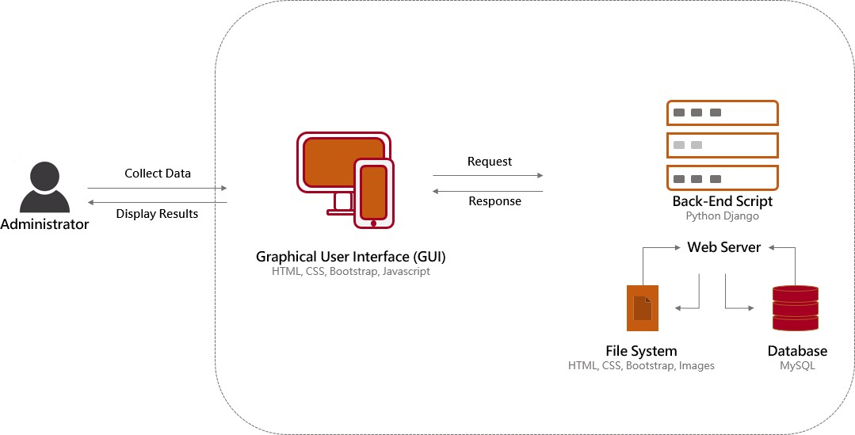
Module Description
2020 - 21
Network Monitor
Fig1 :System Architecture
13

Slide 15
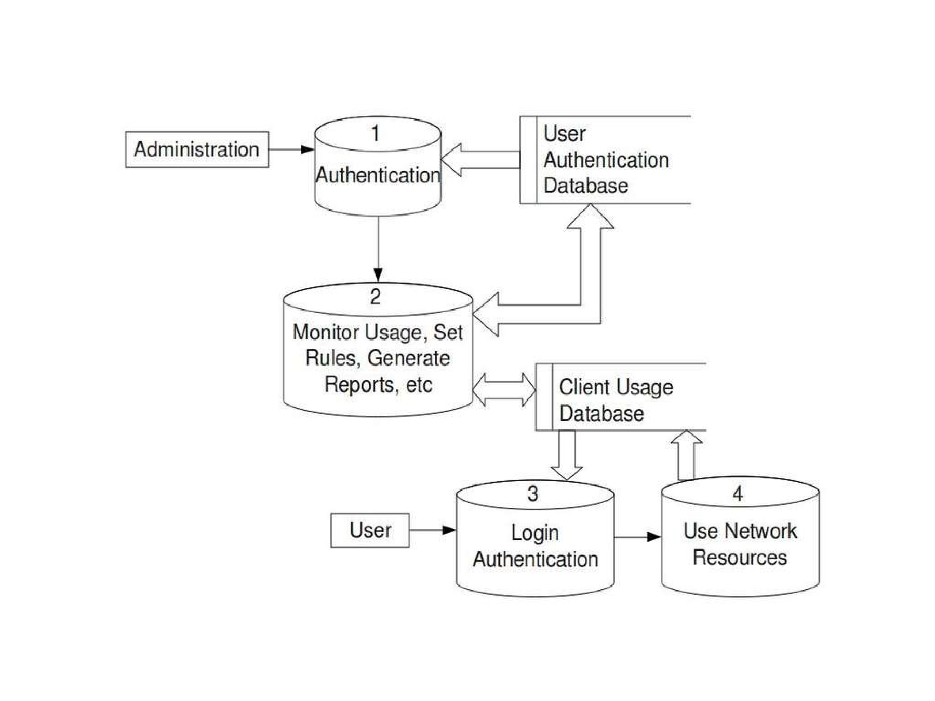
2020 - 21
Network Monitor
Fig2:Data Flow Diagram
14

Slide 16
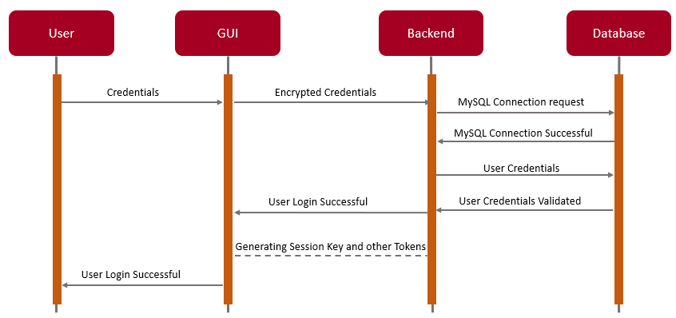
2020 - 21
Network Monitor
Fig3: Sequence Diagram
15

Slide 17
System Testing
2020 - 21
Network Monitor
Test Case ID. | Input Description | Expected Output | Actual Output | Remarks
1 | Enter Registered Username | Registered Username Is valid | Successful Login | Pass
2 | Enter Valid Password | Password entered is Valid | Successful Login | Pass
3 | Enter the devices name | Displaying the Total devices Information | Successful updated the devices Information | Pass
4 | Status of devices | Live/not Reachable | Alert to user if not Reachable | Pass/Fail
16

Slide 18
Network Monitor
2020 - 21
Implementation
Graphical User Interface:
This facilitates the user to login into the system, initiate the utility, whereby detail of the entire network is present in a table.
The Traffic Status will show up eventually which are obtained from the device using ICMP protocol
The user can also see all the performance attributes and so on present on any network node by switching between tabs.
Coding Languages used for this Component: HTML, CSS, Bootstrap Templates.
Back-end Processing:
This module handles all functionality from finding the network nodes, attributes, querying with the network nodes and updating the database with information obtained through back end processing.
17

Slide 19
Network Monitor
2020 - 21
Coding Languages used for this Component: Python, Django Framework.
Database:
This module handles acts a buffer between the backend functionality and the graphical user interface. It provides synchronization between the activities of the user and the backend
SQL Tables used:
UserAuthentication: Deals with user login, logout
Devices: Deals with devices and their attributes at real time
Languages used for this Component: sqlite
18

Slide 20
Network Monitor
2020 - 21
Screen Shots
Fig4: Login page
Fig5: Register page
19

Slide 21
Network Monitor
2020 - 21
Fig6:Profile page
Fig7: Adding the devices
20

Slide 22
Network Monitor
2020 - 21
Fig8: Total Status of devices
21

Slide 23
Expected Outcome
2020 - 21
Network Monitor
A fully functional network monitoring system that can overlay various monitoring protocols such as ICMP, SMTP, ARP, LLDP and so on to obtain all information about various network nodes.
Development of easy installation script setup documentation.
A lucid, user-friendly User Interface for the application that can display information with right intensity
Consistent triggering for alerts in any inconsistent conditions that found in a network
Alerts should be sent to the users configured as per their customizations.
22

Slide 24
Network Monitor
2020 - 21
Conclusion And Future Enhancement
Monitoring a network is very essential, intelligent management of the business. It helps the business grow and prevent them from un- necessary downtime due to inappropriate use of resources.
This tool can be further used in areas such as remote monitoring, where we can monitor branch network of a company from the main office.
23

Slide 25
REFERENCES
2020 - 21
Network Monitor
[1] Network Monitoring System for Network Equipment Availability and Performance Reporting –by Baphumelele Masikisiki, Siyabulela Dyakalashre[2020]
[2] Architecture of a Network Performance Monitor for Application Services on Multi-Clouds – by Young-min Kim, Ki-sung Lee, Jae-cheol Uhm, Si-chang Kim, and Chan-gun Lee 2018
[3] Measurement-Aware Monitor Placement and Routing: A Joint Optimization Approach for Network-Wide Measurements – by Guanyao Huang, Chia-Wei Chang, Chen-Nee Chuah, and Bill Lin 2017
[4] A Web-based monitor and management system architecture for enterprise virtual private network – by Ruey-Shun Chen , Change-Jen Hsu 2019
24

Slide 26
THANK YOU
2020 - 21
Network Monitor
25

